Slide 1
PerfTest: Profiling Applications via ARM and TPTP
Yoonki Song
Last Updated: Sep. 16, 2009

Slide 2
Profiling Applications via ARM
Part I

Slide 3
Using the Java Profiler with JVM 1.4 (or lower)
Go to <profile root>/config/cells/<nodename>Cell/nodes/<nodename>/servers/server1
Edit the jvmEntries element in the server.xml Specifically, append –XrunpiAgent:server=enabled to the genericJvmArguments attribute value.
Restart WSAS

Slide 4
Instrumentation
# /root/perftest/gotoARM.sh
Start WebSphere Application Server (WSAS)
Note: WSAS should be running before applications are instrumented.
Start Instrumentation
Restart the server
Note: This task should be done only once.

Slide 5

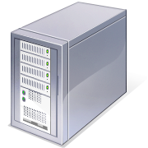

Environment for ARM Instrumentation
Client:
My desktop (Dynamic IP)
Rational Performance Tester v8.0
with Agent (Data Collection Inftrastructure v7.0)
Server:
eb2-2241-grd03.csc.ncsu.edu (152.14.90.72)
WebSphere Application Server v6.1
Rational Performance Tester Agent
(Data Collection Inftrastructure v7.0)

Slide 6

Sequence for Collecting Trace data with Instrumentation (RPT-ARM)
Client
Server
#/root/perftest/startARM.sh
Start Rational Agent Controller (RAC)
Note: RAC should be running prior to DCI
Start Data Collection Infrastructure (DCI)
Note: DCI should be running prior to WSAS
Start WebSphere Application Server (WSAS)
4. Start DCI
5. Start RPTv8.0
6. Start Recording and Launching Test/Schedule via RPT
Trace data (A)
Note: This task should be always done whenever the server/client reboots.
Notes:
3451 <- x
4513 <-

Slide 7
File extensions
Extension | Description
executiondlr
Trcadlr
Trcaxmi | Trace Agent
Trciovxmi
Trcmxmi | Trace Monitor
Trcnxmi | Trace Node
Trcpxmi | Trace Process
trcxml

Slide 8
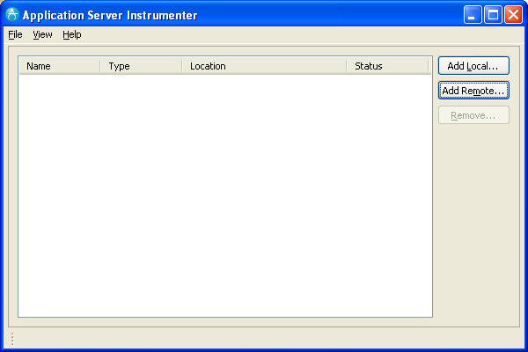
Application Server Instrumenter (ASI)

Slide 9
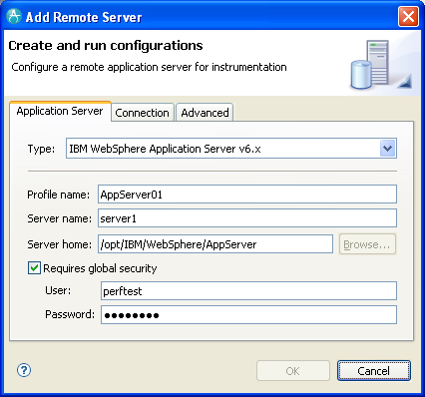
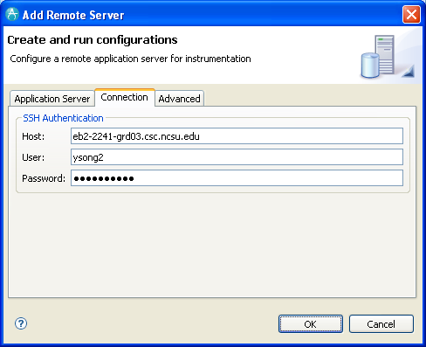
Application Server Instrumenter (ASI)

Slide 10
Application Server Instrumenter (ASI)
Application Server Tab
Type: IBM WebSphere Application Server v6.x
Profile name: AppSrv01
Server name: eb2-2241-grd03.csc.ncsu.edu
Server home: /opt/IBM/WebSphere/AppServer
User: perftest
Password: perftest
Connection Tab
Host: eb2-2241-grd03.csc.ncsu.edu or ldap.ncsu.edu (?)
User: ysong2
Password: <?>

Slide 11
…
{WAS_PROFILE_HOME}/config/cells/{cell_name}/nodes/{node_name}/servers/{server_name}
/opt/IBM/WebSphere/AppServer/profiles/AppSrv01/config/cells/eb2-2241-grd03Node01Cell/nodes/eb2-2241-grd03Node01/servers/server1/server.xml
/opt/IBM/WebSphere/AppServer/profiles/AppSrv01/config/cells/eb2-2241-grd03Node01Cell/nodes/eb2-2241-grd03Node01/servers/server1/variables.xml
{WAS_PROFILE_HOME}/config/cells/{cell_name}
/opt/IBM/WebSphere/AppServer/profiles/AppSrv01/config/cells/eb2-2241-grd03Node01Cell/pmirm.xml

Slide 12
…
/opt/IBM/SDP/DCI/rpa_prod/tivoli_comp/app/instrument/6.103.0000/appServers/server1_101/config

Slide 13
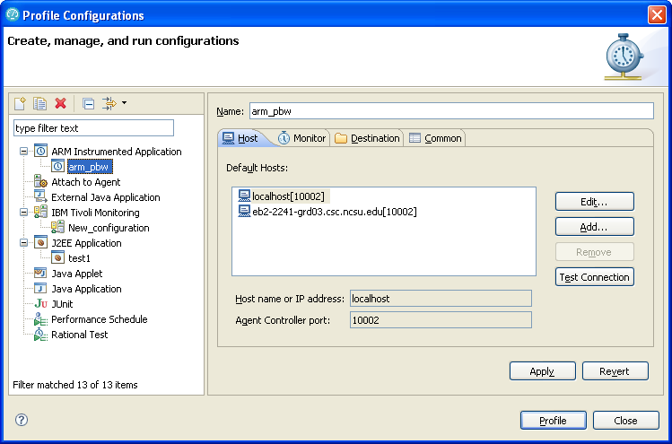
Profile Configurations

Slide 14
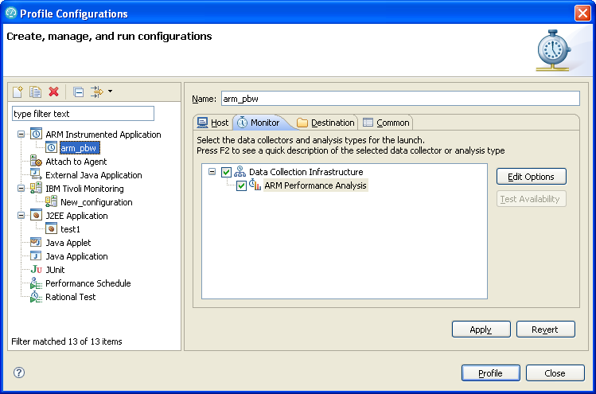
Profile Configurations (Cont’d)

Slide 15
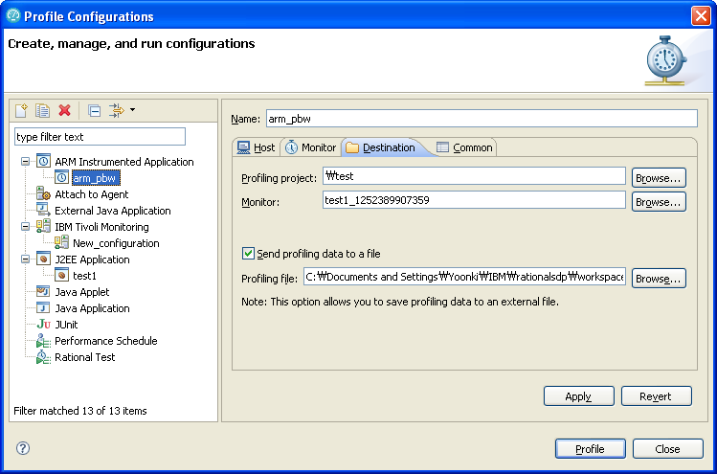
Profile Configurations (Cont’d)

Slide 16
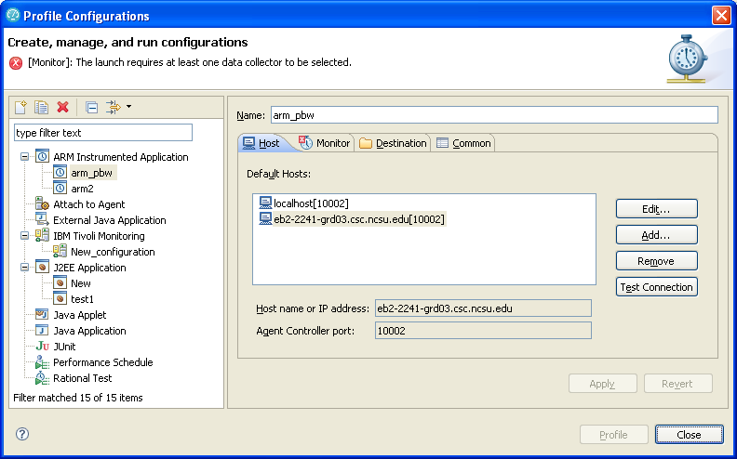

Slide 17
Profiling Applications via TPTP
Part II

Slide 18
Environment for non-ARM Instrumentation
Client:
My laptop (Dynamic IP)
Java 1.5 or lower
TPTP all-in-one v4.5.1
Server:
eb2-2241-grd02.csc.ncsu.edu (152.14.90.8)
Java 1.5 or lower
WebSphere Application Server v6.1
Standalone Agent Controller

Slide 19

Sequence for Collecting Trace data with non-ARM Instrumentation(TPTP)
Client
Server
/root/perftest/*.sh
Start TPTP Agent Controller (TPTP-AC)
Start WebSphere Application Server (WSAS)
3. Use TPTP to collect trace data
4. Our plug-in analyzes trace data (B)
Trace data (B)

Slide 20
Environment Variables on Windows
JAVA_PROFILER_HOME=%TPTP_AC_HOME%\plugins\org.eclipse.tptp.javaprofiler
TPTP_AC_HOME=C:\DevTools\eclipse\tptp.runtime.allInOne.win32.win32.x86-TPTP-4.5.1
PATH=%PATH%;%JAVA_PROFILER_HOME%;%TPTP_AC_HOME%\bin

Slide 21
.bashrc on Linux
# “PerftTest(ARM)” project
# “PerftTest(TPTP)” project
export TPTP_AC_HOME=/opt/TPTP
export JAVA_PROFILER_HOME=$TPTP_AC_HOME/plugins/org.eclipse.tptp.javaprofiler
export PATH=$TPTP_AC_HOME/bin:$JAVA_PROFILER_HOME
export LD_LIBRARY_HOME=$LD_LIBRARY_HOME:

Slide 23
Workaround: Converting ARM-instrumented to TPTP Environment
Client
Server
Check if WSAS is running
If not, start WSAS
Un-instrumentation
Reboot the server

Slide 24
Comparing Trace data from RPT and TPTP

Slide 25
Start the Plant web application (AppSrv02, 9083, 9063)
Setup the environment for RPT profiling
Create a performance test suite for the Plant web application.
Run the performance test suite by RPT while collecting profiling data by RPT. The profiling data is stored in a local trcxml file (t1_rpt.trcxml)
Restart the Plant web application (after uninstrumentation)
Setup the environment for TPTP profiling
Run the performance test suite by RPT while collecting profiling data by TPTP. The profiling data is stored in a local trcxml file (t1_tptp.trcxml)
Compare t1_rpt.trcxml and t1_tptp.trcxml to figure out the difference.

Slide 26
Trouble Shooting

Slide 27
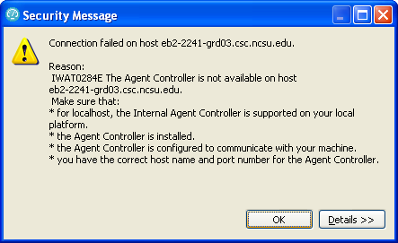
IWAT0284E
IWAT0284E

Slide 28
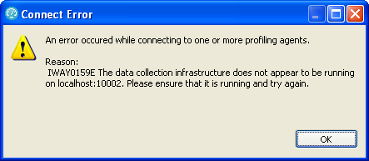
IWAY0159E

Slide 29
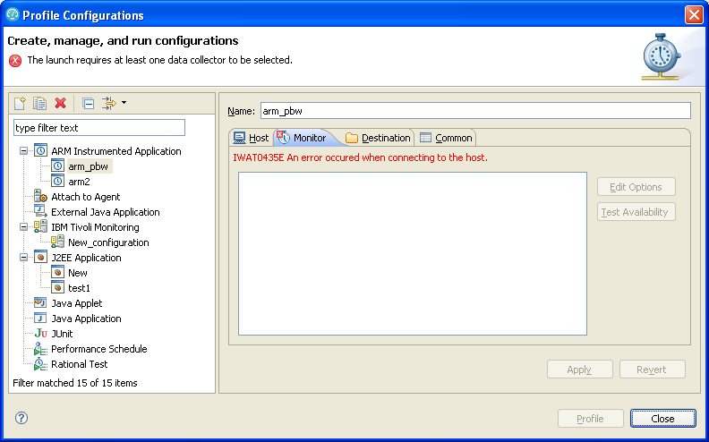
IWAT0435E

Slide 30
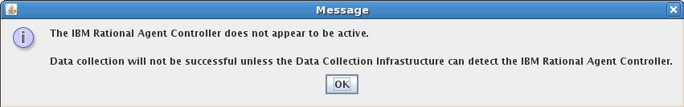
Trouble Shooting

Slide 31
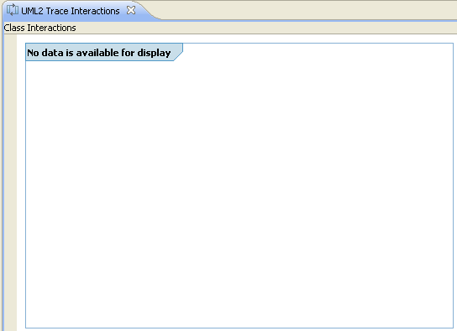
No data available for display
No data available for display

Slide 32
Hang “Connecting to the JVMPI agent”
My guess is that JVMTI (1.6) cannot deal with multi-threaded applications

Slide 33
References
Install WebSphere Application Server V6.0 for Linux on POWER (http://www.ibm.com/developerworks/systems/library/es-webapp/index.html)
WebSphere Application Server 6.1 Headless Install (http://bishop.camp.clarkson.edu/wiki/en/WebSphere_Application_Server_6.1_Headless_Install)

Slide 34
References
Using IBM Rational Performance Tester: Application Monitoring Part 1, Configuring your environment (http://www.ibm.com/developerworks/rational/library/07/0515_patel/index.html)
Using IBM Rational Performance Tester: Application Monitoring Part 2, Enabling real-time monitoring (http://www.ibm.com/developerworks/rational/library/07/0515_patel2/index.html)
Using IBM Rational Performance Tester: Application monitoring, Part 3: Importing data from IBM Tivoli database products (http://www.ibm.com/developerworks/rational/library/07/0605_patel/index.html)

